Slide 1
Healthcare Analytics: Patient Journey Mapping
Presented By: SIMMI KUMARI

Slide 2
Problem Statement:
Map the patient journey within a healthcare system, from admission to discharge. Highlight opportunities to enhance patient experience and optimize operational efficiency.

Slide 3







Dataset Contents
05

Slide 4



Cleaning and Creating Dashboard ON

Slide 5
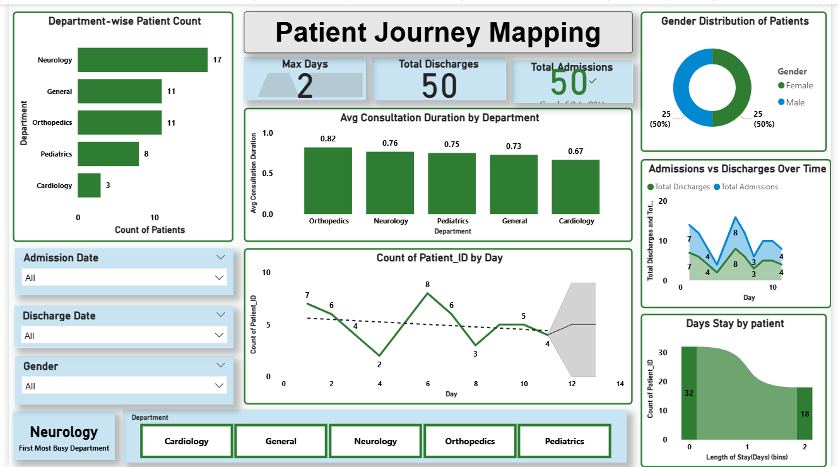

Slide 6
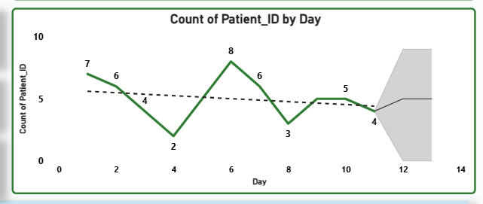

Slide 7





Slide 8



2

Slide 9
Recommendations
Resource Allocation
Focus on Neurology
Scheduling Optimization
By extra staffing
Patient Care Efficiency Why Orthopedics
Future Planning
Equipment and bed allocation
Balanced Gender Care
Ensure Departmental

Slide 10


Thankyou

